Slide 1
«SPORT FOR INTERCULTURAL DIALOGUE»
ERASMUS PLUS PROJECT:
ACTIVITY SPORT ID DAY ITALIAN EDITION

Slide 2
The following actions have been provided for making the sport id day:
-identification of stakeholders for multiplying the activities;
-cooperation with different sports associations present on the territory distinguished by the type of sport;
-collaborations with public authorities that supports the initiative;

Slide 3
Sports associations involved
ASD LONGOMBARDA – FOOTBALL
ASD RARINANTES – swimming
ASD PDO – handball

Slide 4
Institutionals partners:
Municipality of salerno
Social services of the municipality of salerno

Slide 5
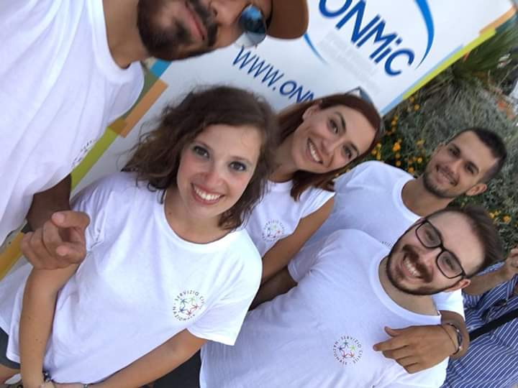
64 YOUNGS DOING CIVIL SERVICE BETWEEN THE AGE OF 18 AND 29 YEARS
STAKEOLDERS

Slide 6
60 STUDENTS WITH A MINIMAL AGE OF 18 YEARS INVOLVED IN THE EDUCATION WITHIN THE PROJECT «YOUNG LEADER FOR LEGALITY»
STAKEOLDERS

Slide 7
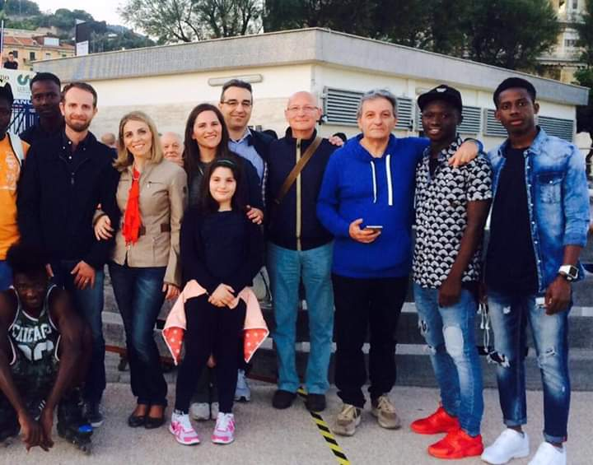
100 UNACCOMPANIED FOREIGN MINORS;
STAKEOLDERS

Slide 8
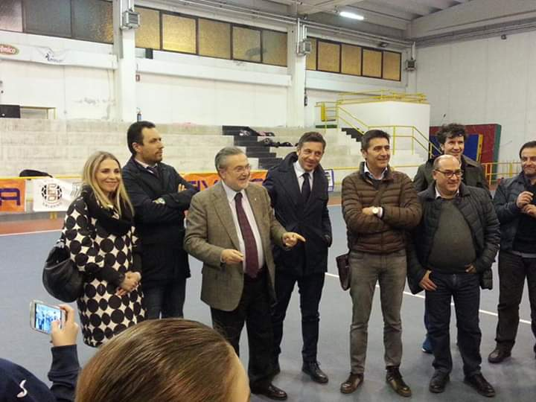
40 SPORTS TRAINERS;
STAKEOLDERS

Slide 9
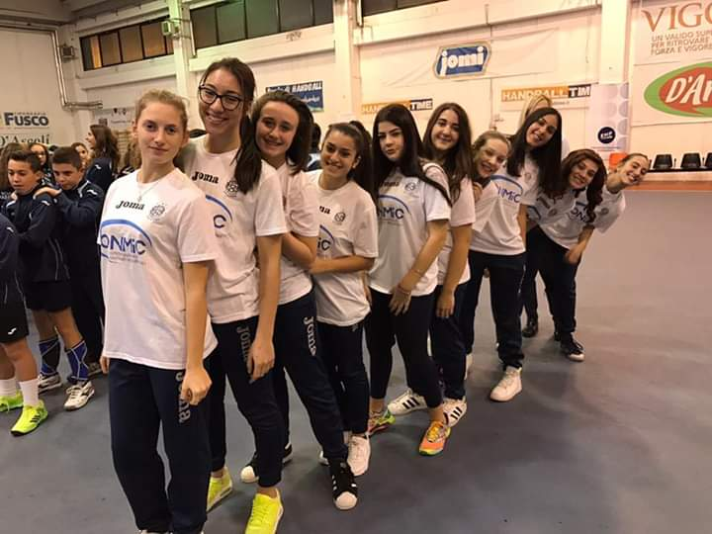
100 YOUNG ITALIANS SPORTS;
STAKEOLDERS

Slide 10
TYPES OF PROMOTED SPORTS
SWIMMING
VOLLEYBALL
FOOTBALL
SKATING

